Slide 1
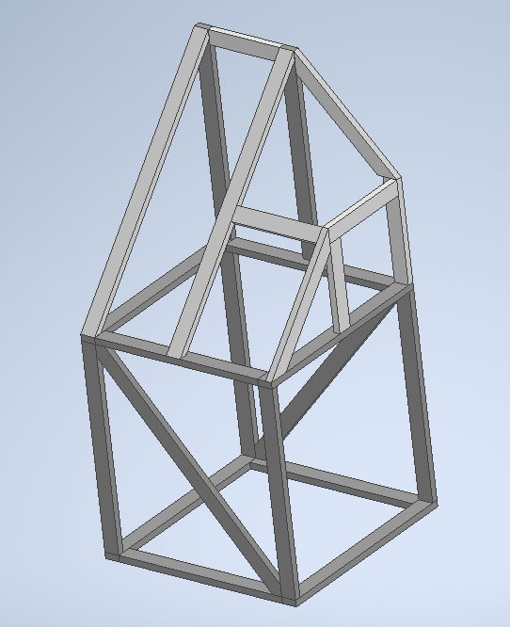
LEFT shoulder
1.5 2x4x8
7 2x4x12
Very important to be using the right pieces and board sizes!!! Please keep track and label boards as you cut!!

Slide 2
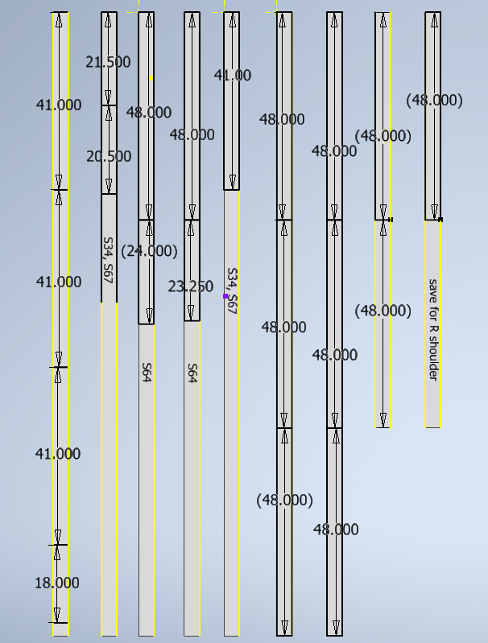
(2) 2x4x8
(7) 2x4x12
Mark and cut boards like this →
Label each board as written here and keep together
Very important to be using the right pieces and board sizes!!! Please keep track and label boards as you cut!!

Slide 3
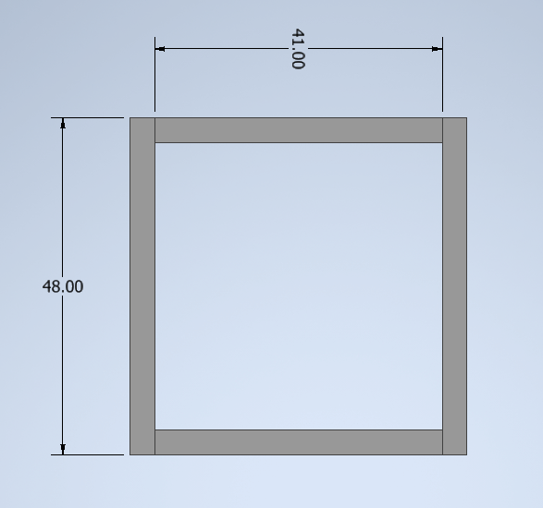
(2) 48”
(2) 41”

Slide 4
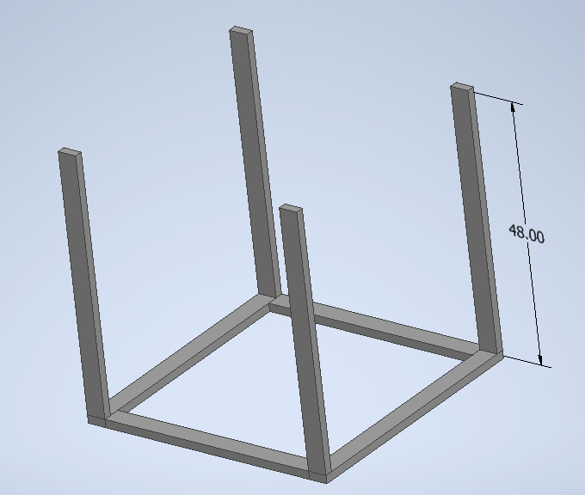
(4) 48”

Slide 5
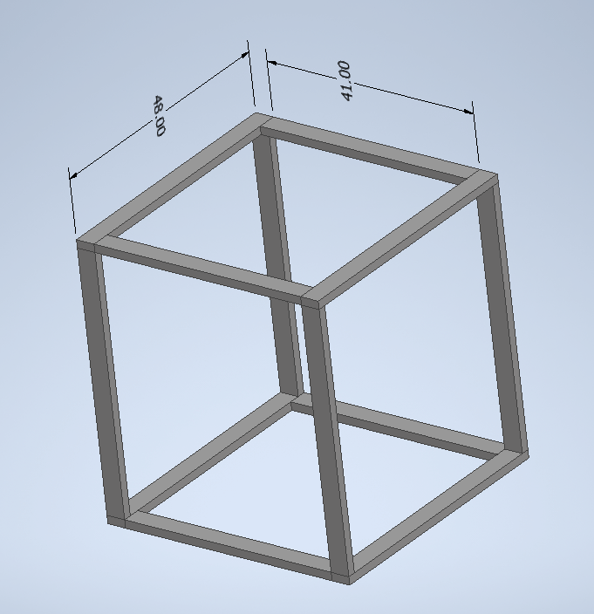
(2) 48”
(2) 41”

Slide 6
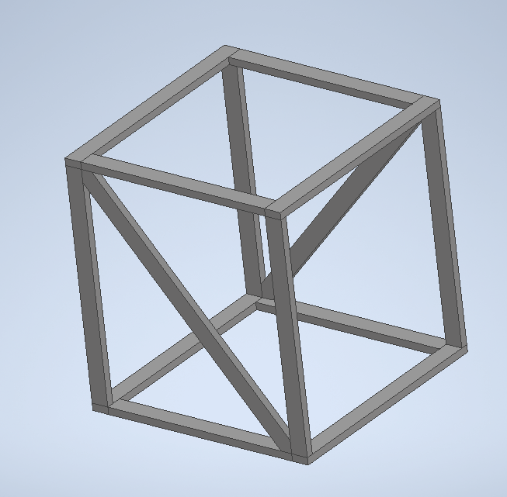
Use the 2 pieces marked S64, one cut from each

Slide 7
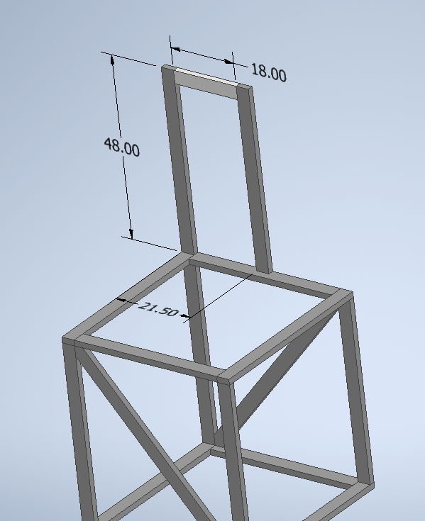
(2) 48”
(1) 18”

Slide 8
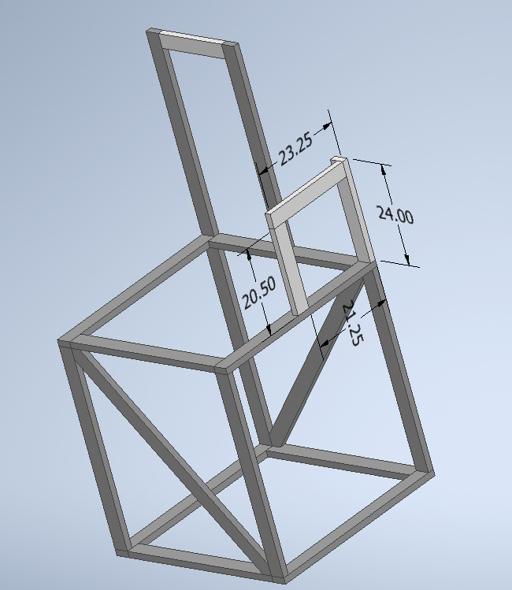
20.5”
(1) 24”
(1) 23.25”

Slide 9
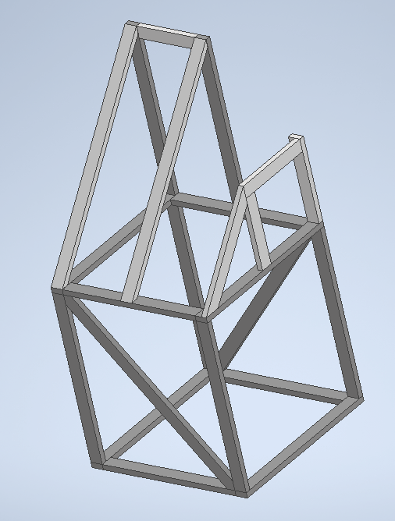
(2) S67
(1) S34

Slide 10
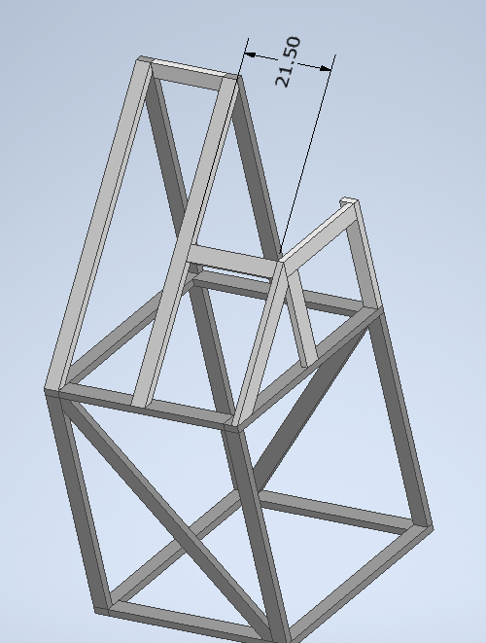
21.5”

Slide 11
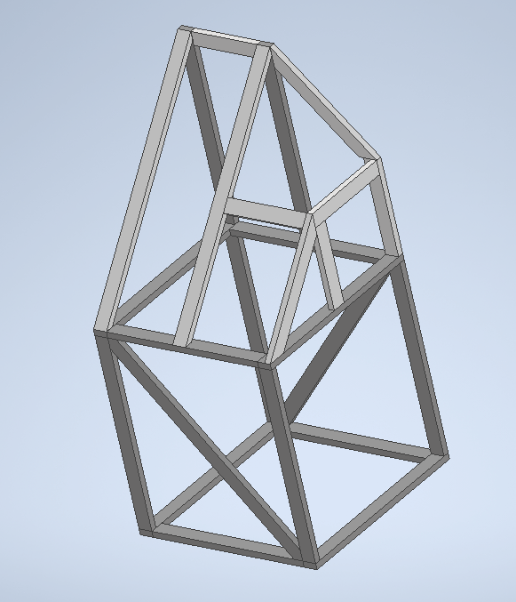
(1) S34

